Slide 1
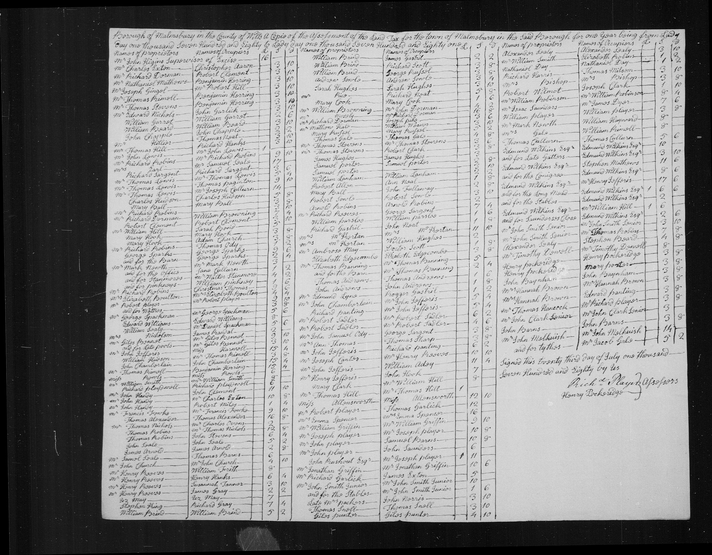
Land Tax in England & Wales
1780 to 1832

Slide 2
Land Tax over the Years
A land tax was imposed in 1692 to pay for a war with France
Administered locally & hardly any records survive
From 1780 to 1832 the tax list was used as voter qualification
Most records have survived in Quarter Session Records
Have been filmed by LDS
Now digitised and available on Family Search at the library
Not indexed
Few records after 1832
Abolished in 1963

Slide 3
The Tax
Nominally tax of 4/- per £1 value ie 20%
Before 1794 Roman Catholics paid double
A quota of the total land valuation was assigned to each county
A quota was then assigned to each parish
Local unpaid commissioners/collectors allocated tax to individual properties
Result was a fixed tax per property that did not change
EXCEPT sometimes quotas were adjusted between parishes; one would pay more and another one less. That change affected all the parish properties

Slide 4
Exonerated Taxes
In time inflation resulted in less income to the government
1798 & 1799 - Became possible to “exonerate” or “redeem” your tax by a lump sum payment of 15 years worth of tax
Freeholders in general took advantage of that; not so many lease or copyholders as they were less certain of their future tenure of the land
Exonerated taxes were still listed in the annual lists until 1832, as they were needed for voter registration.
Tax records after 1832 probably only non- exonerated taxes
Ancestry has images of redemption records and they are indexed by name of owner & occupier. Search catalog for “land tax” and choose “UK, Land Tax Redemption 1798”
Easy way to check if a person appears in land tax records at all

Slide 5
Record showing the date of a tax redemption contract

Slide 6
On Line Access to Annual Tax Records
Family Search - un-indexed films viewable at the library when logged on to Family Search as Hibiscus Coast Genealogy.
Ancestry has images of records for Bedfordshire, Gloucestershire, West Yorkshire, Surrey, London, Dorset & Warwickshire. Indexed except for Dorset
Find My Past has images of land tax records for Cheshire, Devon & Norfolk. Indexed except for Norfolk.
Not sure how complete any of these collections are
Download any images of interest to your computer

Slide 7
What is on the Tax List
Not a lot - name of “owner” or “proprietor”, name of occupier and the tax
The owner/proprietor may have been a freeholder, leaseholder or copyholder. You can’t tell which.
From 1800 the tax was recorded as either “exonerated” or “not exonerated”, either in separate lists or mixed together with exonerated tax and non-exonerated tax in separate columns
If you are looking for a person in a town you will be looking through several pages of images for every year
If you are looking at a village or a tithing the list is much shorter and it is much easier to find people - the farmers, if not the ag labs

Slide 8
About 1/12 th of the records for Malmesbury Borough

Slide 9
The entire list for the Tything of Rodbourne in Malmesbury Parish in 1784
In this list most of the “proprietors” are leaseholders, not freehold land owners

Slide 10
What Can You Find Easily?
Whether your family member was a “proprietor” or not - Look for deeds, eg on “Discovery Archives” website
If your person was a tax collector they were of some standing in the community
By comparing records over the years you can find arrival and departure dates (possibly a year or two after the event)
Look for who had the property before and afterwards - very likely to be a relative. If Mrs Surname or Widow Surname shows up you might have an otherwise un-recorded death
If your person was the occupant check who the landowner was. If a major landowner, records may be in archives other than the County one, or in private hands
Might be able to correlate with tithe records and 1841 census

Slide 11
Example 1 - Malmesbury Houses
Downloaded all 272 images of the Malmesbury records
Picked out all the occurrences of my Handy family, their predecessors and successors
As the tax remained the same and fortunately no houses were taxed the same amount the houses could be separated
Made a spreadsheet of all that and could see that John Handy had two investment houses in Malmesbury from 1780 before he retired there about 1803 from a farm in Gloucestershire
His married son lived in one of his houses and another was rented to extended family until John arrived in town. He then picked up two more investment houses.
John and his son (also a John Handy) swapped the two original houses about 1806
After John the son died in 1810 his widow sold the house to a bank

Slide 12
Malmesbury Houses continued
All that is fine information, but where were the houses?
The order that the tax list was written varied - sometimes alphabetical, but usually not and seemingly in some sort of “walk-around-town” order that was more or less the same
The breakthrough came when I noticed a pattern that I thought was “side of street” order.
Expanded my spreadsheet to accommodate intervening houses (now 8 columns wide)
The bank was a bit of an anchor point, but the main evidence came from an 1845 survey map of Malmesbury Manor
Just showed leasehold properties and 1845 was well after John Handy died in 1813 but there were enough matching names to be sure

Slide 13
John Handy sen lived at 43 & 43a High Street

Slide 14
Example 2 - Malmesbury Workhouses
Another exercise in tracing houses between 1780 and 1830
I did this because two of the workhouses mentioned in other records had family connections but the dates for their existence were very unclear in published sources.
One, later called the Tower House, was “formerly the Salutation Inn”. The dates for that were unknown, and alas still unknown, but has to be before 1780.

Slide 16
The Tower House

Slide 17
A Farm Example
Thomas Handy’s Land Tax:
 | Thomas Handy | John Peters | George Russell | Total
1780 | £7:13:5 | £4:7:2 | £0:17:9 | £12:18:4
1782-1796 | £12:18:4
This transfer is partially confirmed in Thomas Handy’s 1786 deed when two new fields appeared compared to his previous lease:
“two closes of meadow or pasture called Neats and Styles Hays formerly Godwins 15A formerly in the tenure of George Russell but now of Thomas Handy”

